Slide 1
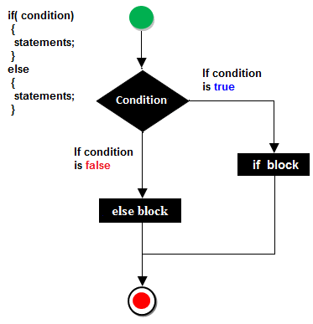
Java- Flow Control

Slide 2
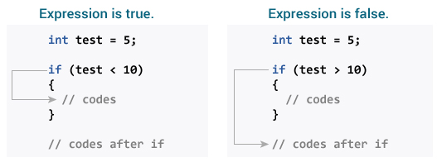
In programming, it's often desirable to execute a certain section of code based upon whether the specified condition is true or false (which is known only during the run time). For such cases, control flow statements are used.
Java if Statement
The syntax of if-then statement in Java is:
if (expression) {
// statements
}
Here expression is a boolean expression (returns either true or false).
If the expression is evaluated to true, statement(s) inside the body of if (statements inside parenthesis) are executed.
If the expression is evaluated to false, statement(s) inside the body of if are skipped from execution.
How if statement works in Java? (IfStatement.java)

Slide 3
When you run the program, the output will be:
Number is positive.
This statement is always executed.
When number is 10, the test expression number > 0 is evaluated to true. Hence, codes inside the body of if statements are executed.
Now, change the value of number to a negative integer. Let's say -5. The output in this case will be:
This statement is always executed.
When number is -5, the test expression number > 0 is evaluated to false. Hence, Java compiler skips the execution of body of if statement.

Slide 4
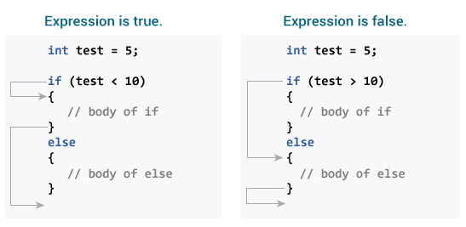
Java if...else Statement
The if statement executes a certain section of code if the test expression is evaluated to true. The if statement can have optional else statement. Codes inside the body of else statement are executed if the test expression is false.
The syntax of if-then-else statement is:
if (expression) {
// codes
}
else {
// some other code
}
How if...else statement works?

Slide 5
When you run the program, the output will be:
Number is positive.
This statement is always executed.
When number is 10, the test expression number > 0 is evaluated to true. In this case, codes inside the body of if are executed, and codes inside the body of else statements are skipped from execution.
Now, change the value of number to a negative number. Let's say -5. The output in this case will be:
Number is not positive.
This statement is always executed.
When number is -5, the test expression number > 0 is evaluated to false. In this case, codes inside the body of else are executed, and codes inside the body of if statements are skipped from execution.

Slide 6
Java if..else..if Statement
In Java, it's possible to execute one block of code among many. For that, you can use if..else...if ladder.
    if (expression1)
    {
    // codes
    }
    else if(expression2)
    {
    // codes
    }
    else if (expression3)
    {
    // codes
    }
    .
    .
    else
    {
    // codes
    }
The if statements are executed from the top towards the bottom. As soon as the test expression is true, codes inside the body of that if statement is executed. Then, the control of program jumps outside if-else-if ladder.
If all test expressions are false, codes inside the body of else is executed.

Slide 7
IfElseladder.java
When you run the program, the output will be:
Number is 0.
When number is 0, both test expression number > 0 and number < 0 is evaluated to false. Hence, the statement inside the body of else is executed.
The above program checks whether number is positive, negative or 0.

Slide 8
Java Nested if..else Statement
It's possible to have if..else statements inside a if..else statement in Java. It's called nested if...else statement.
Here's a program to find largest of 3 numbers:
NestedIfElse.java
When you run the program, the output will be:
Largest number is 4.5
Note: In above programs, we have assigned value of variables ourselves to make this easier. However, in real world applications, these values may come from user input data, log files, form submission etc.
You should also check ternary operator in Java, which is kind of shorthand notation of if...else statement.

Slide 9
Java- switch statement
In Java, the if..else..if ladder executes a block of code among many blocks.
The switch statement can a substitute for long if..else..if ladders which generally makes your code more readable.
The syntax of switch statement is:
    switch (variable/expression) {
    case value1:
    // statements
    break;
    case value2:
    // statements
    break;
    .. .. ...
    .. .. ...
    default:
    // statements
    }

Slide 10
The switch statement evaluates it's expression (mostly variable) and compares with values(can be expression) of each case label.
The switch statement executes all statements of the matching case label.
Suppose, the variable/expression is equal to value2. In this case, all statements of that matching case is executed.
Notice, the use of break statement. This statement terminates the execution of switch statement.
The break statements are important because if they are not used, all statements after the matching case label are executed in sequence until the end of switch statement.
It's also important to note that switch statement in Java only works with:
Primitive data types: byte, short, char and int
Enumerated types (Java enums)
String class
a few classes that wrap primitive types: Character, Byte, Short, and Integer.
SwitchStatement.java

Slide 11
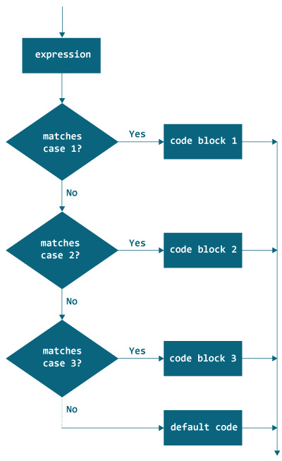

Slide 12
Java- Loops
Loop is used in programming to repeat a specific block of code until certain condition is met (test expression is false).
Loops are what makes computers interesting machines. Imagine you need to print a sentence 50 times on your screen. Well, you can do it by using print statement 50 times (without using loops). How about you need to print a sentence one million times? You need to use loops.
Java for Loop
The syntax of for Loop in Java is:
for (initialization; testExpression; update) {
// codes inside for loop's body
}
How for loop works?
The initialization expression is executed only once.
Then, the test expression is evaluated. Here, test expression is a boolean expression.
If the test expression is evaluated to true,
  Codes inside the body of for loop is executed.
  Then the update expression is executed.
  Again, the test expression is evaluated.
  If the test expression is true, codes inside the body of for loop is executed and update expression is executed.
  This process goes on until the test expression is evaluated to false.
If the test expression is evaluated to false, for loop terminates.

Slide 13
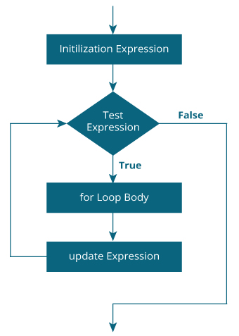
Java – Loop Flowchart

Slide 14
ForLoop.java
When you run the program, the output will be:
Line 1
Line 2
Line 3
Line 4
Line 5
Line 6
Line 7
Line 8
Line 9
Line 10
Here, the variable i is declared and initialized to 1.
Then, the test expression i <= 10 is evaluated. Since, it's true, the body of for loop is executed which prints Line 1 on the screen.
Then, the update expression ++i is executed. Now, the value of i is increased to 2. Again the expression i <= 10 is evaluated which is true and the body of for loop is executed which prints Line 2 on the screen.
This iteration process goes on until i is 11. When i is 11, expression i <= 10 is false and for loop terminates.
SummingUpNumbers.java

Slide 15
When you run the program, the output will be:
Sum = 500500
Here, the variable sum is initialized to 0. Then, in each iteration of for loop, variable sum is assigned sum + i and the value of i is increased until i is greater than 1000. For better visualization,
1st iteration: sum = 0+1 = 1
2nd iteration: sum = 1+2 = 3
3rd iteration: sum = 3+3 = 6
4th iteration: sum = 6+4 = 10
... .. ...
999th iteration: sum = 498501 + 999 = 499500
1000th iteration: sum = 499500 + 1000 = 500500

Slide 16
infinite for Loop
If the test expression is never false, for loop will run forever. This is called infinite for loop. Let's take an example:
// Infinite for Loop
class InfiniteLoop {
public static void main(String[] args) {
int sum = 0;
for (int i = 1; i <= 10; --i) {
System.out.println("Hello");
}
}
}
Here, the test expression i <= 10 is never false and hello is printed infinite number to times (at least in theory).
The initialization, update and test expression used in for statement is optional. Here's an another example of infinite for loop.
for ( ; ; ) {
}

Slide 17
Java- for-each Enhanced for Loop
If you are working with arrays and collections, you can use alternative syntax of for loop (enhanced form of for loop) to iterate through items of arrays/collections. It is also referred as for-each loop because the loop iterates through each element of array/collection.
To learn about standard syntax of for loop, arrays and collections, visit:
Java for Loop
Java arrays
Java collections
Here's an example to iterate through elements of an array using standard for loop:
class ForLoop {
public static void main(String[] args) {
char[] vowels = {'a', 'e', 'i', 'o', 'u'};
for (int i = 0; i < vowels.length; ++ i) {
System.out.println(vowels[i]);
}
}
} ForEachExample.java

Slide 18
You can perform the same task using for-each loop as follows:
class ForEach {
public static void main(String[] args) {
char[] vowels = {'a', 'e', 'i', 'o', 'u'};
// foreach loop
for (char item: vowels) {
System.out.println(item);
}
}
}
The output of both programs will be same:
a
e
i
o
u
The use of enhanced for loop is easier to write and makes your code more readable. Hence, it's recommended over standard form whenever possible.

Slide 19
Syntax of for-each loop
Let's first look at the syntax of for each loop:
for(data_type item : collection) {
...
}
In the above syntax, collection is a collection or array variable which you have to loop through. item is a single item from the collection.
How for-each loop works?
Here's how the enhanced for loop works. For each iteration, for-each loop
iterates through each item in the given collection or array (collection), stores each item in a variable (item) and executes the body of the loop.
collection is a collection or array variable which you have to loop through.
item is a single item from the collection.
For each iteration, for-each loop iterates through each item in the given collection or array (collection), stores each item in a variable (item) and executes the body of the loop. Let's make it clear through an example.
EnhancedForLoop.java

Slide 20
Java- while loop
The while loop is the most fundamental loop statement of Java. It repeats a statement or block while its controlling expression is true. Here is the general form of while loop in Java:
while(condition)
{
// body of the loop
}
The condition can be any Boolean expression. The body of the loop will be executed as long as the conditional expression is true. When the condition becomes false, the control passes to the next line of code immediately following the loop. The curly braces are unnecessary if only a single statement is being repeated.
WhileLoop.java
Since the while loop evaluates its conditional expression at the top of the loop, the body of the loop will not execute even once if the condition is false to begin with. For example, in the following code fragment, the call to println() is never executed:
int a = 10, b = 20;
while(a > b)
{
System.out.println("This will not be displayed.");
}
The body of the while loop can be empty. This is because a null statement (once that consists only of a semicolon) is syntactically valid in Java. For example, consider the following program:

Slide 21
Java- do-while Loop
The do-while loop executes a block of code while a boolean expression evaluates to true. It checks the boolean expression after each iteration. It terminates as soon as the expression evaluates to false.
Syntax
do {
//block of code to be executed
} while(booleanExpression);
Notes
Because the do-while loop evaluates the boolean expression at the end of the iteration, the block of code within the loop is guaranteed to run at least once.
booleanExpression results in either a true or false output. It is created using comparing operators (==, >, =, <=, !=).
There can also be multiple boolean expressions within the parentheses (booleanExpression). The boolean expressions are connected through logical operators (&&, ||, !).
int x = 0;
do {
System.out.println(x);
x++;
} while(x < 10);

Slide 22
The while statement may not execute at all, depending on the expression used as the loop ending condition. In contrast, the do-while statement always executes at least once, such as when handling menuOptions. The syntax of the command is:
do {
action;
} while (expression);
There are two wonderful examples of the Do-While loop: A menu and finding a file.
Menu
A great use for the Do-While loop is the menu: The menu is displayed continuously until the end user picks a value. If they type a certain menu item, then the code stops. While the example below may look complicated, pay close attention to the beginning and end of the code: Remember the condition is checked at the end! This ensures the full menu will always be there until the user types a 3.
int menuOption;
...
do {
System.out.print("Enter menu option: ");
menuOption = keyboard.nextInt();
if ( menuOption > 5) {
System.out.print("Invalid entry, please enter a new option: ");
continue; // Repeat loop from the top
}
} while (menuOption > 5)

Slide 23
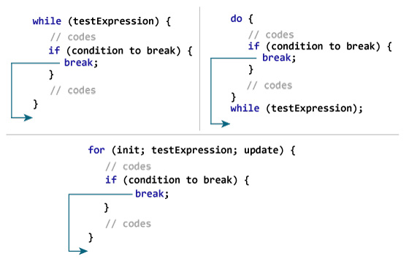
Java- break Statement
Suppose you are working with loops. It is sometimes desirable to skip some statements inside the loop or terminate the loop immediately without checking the test expression. In such cases, break and continue statements are used.
The break statement terminates the loop immediately, and the control of the program moves to the next statement following the loop.
The break statement in Java programming language has the following two usages −
When the break statement is encountered inside a loop, the loop is immediately terminated and the program control resumes at the next statement following the loop.
It can be used to terminate a case in the switch statement
It is almost always used with decision making statements (if...else Statement).
The syntax of a break statement is: break;

Slide 24
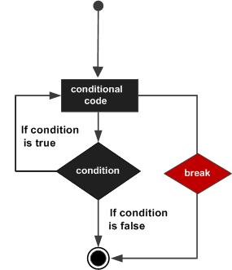
Example 1: Java break statement
class Test {
public static void main(String[] args) {
for (int i = 1; i <= 10; ++i) {
if (i == 5) {
break;
}
System.out.println(i);
}
}
}
When you run the program, the output will be:
1
2
3
4
In the above program, when the value of i becomes 5, expression i == 5 inside the parenthesis of if statement is evaluated to true. Then, The break statement is executed terminates the for loop.

Slide 25
Java break statement
The program below calculates the sum of numbers entered by the user until user enters a negative number.
Breaking.java
To take input from the user, Scanner object is used. Visit Java Basic Input to learn more on how to take input from the user.
When you run the program, you will get similar output like this:
UserInputSum.java
Enter a number: 3.2
Enter a number: 5
Enter a number: 2.3
Enter a number: 0
Enter a number: -4.5
Sum = 10.5
In the above program, the test expression of the while loop is always true.
Here, the while loop runs until user enters a negative number. If user inputs negative number, break statement inside the body of if statement is executed which terminates the while loop.

Slide 26
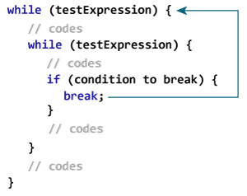
In case of nested loops, break terminates the innermost loop.
How break statement works with nested loops?
Here, the break statement terminates the innermost while loop, and control jumps to the outer loop.
Labeled break Statement
The break statement we have discussed till now is unlabeled form of break statement, which terminates the innermost for, while, do..while and switch statement. There is another form of break statement, labeled break, that can be used to terminate the outer loop.

Slide 27
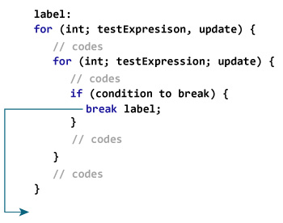
How labeled break statement works?
Here, label is an identifier. When break statement executes, it terminates the labeled statement, and control of the program jumps to the statement immediately following the labeled statement.
Here's another example:
while (testExpression) {
// codes
second:
while (testExpression) {
// codes
while(testExpression) {
// codes
break second;
}
}
// control jumps here
}
When break second; executes, control jumps to the statement following the labeled statement second.
Labelledbreak.java

Slide 28
When you run the program, the output will be:
i = 1; j = 1
i = 1; j = 2
i = 2; j = 1
Here's a variation of the above program. The break statement in the program below terminates label second, and control jumps to the statement following labeled statement second.
LabelledBreak1.java
When you run the program, the output will be:
i = 1; j = 1
i = 1; j = 2
i = 2; j = 1
i = 3; j = 1
i = 3; j = 2
i = 4; j = 1
i = 4; j = 2
The break statement is also used to terminate switch statement. To learn more, visit Java switch statement.

Slide 29
Java- continue statement
On certain occasions, it is useful to force an early iteration of the loop i.e., you might want to continue running the loop but stop processing the remainder of code in its body for this particular iteration. This is, in effect, a goto just pass the body of the loop to the end of the loop. The continue statement performs such an action.
In while and do-while loops, the continue statement causes a control to be transferred directly to the conditional expression that controls the loop. In the for loop, the control goes first to the iteration portion of the for statement and then to the conditional expression. And for all three loops (for, while, and do-while), any intermediate code is bypassed.
The continue keyword can be used in any of the loop control structures. It causes the loop to immediately jump to the next iteration of the loop.
In a for loop, the continue keyword causes control to immediately jump to the update statement.
In a while loop or do/while loop, control immediately jumps to the Boolean expression.

Slide 30
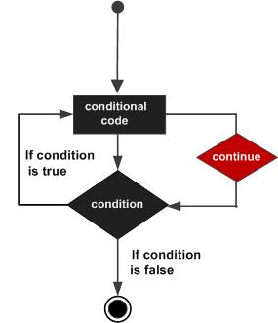

Slide 31
As with the break statement, continue may define a label to report which enclosing loop to continue. Here is an example program that uses the continue keyword to print the triangular multiplication table for 0 though 9 :
ContinueTriangle.java
When the above Java program is compile and executed, it will produce the following output:
C:\Java_Training_2018\Programs>javac ContinueTriangle.java
C:\Java_Training_2018\Programs>java -cp . ContinueTriangle
0
0 1
0 2 4
0 3 6 9
0 4 8 12 16
0 5 10 15 20 25
0 6 12 18 24 30 36
0 7 14 21 28 35 42 49
0 8 16 24 32 40 48 56 64
0 9 18 27 36 45 54 63 72 81
C:\Java_Training_2018\Programs>
The continue statement in above example terminates the loop counting j and then continues with the next iteration of the loop counting i.

